Slide 1

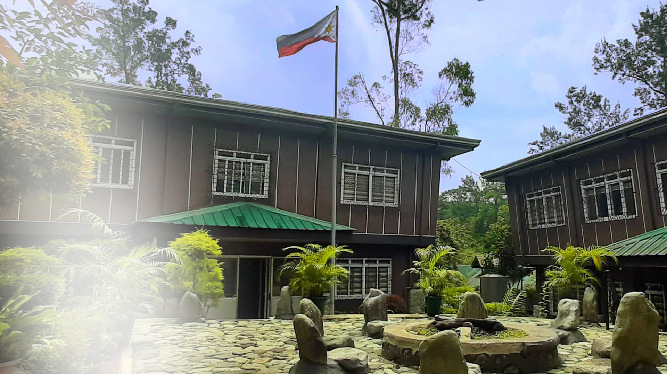
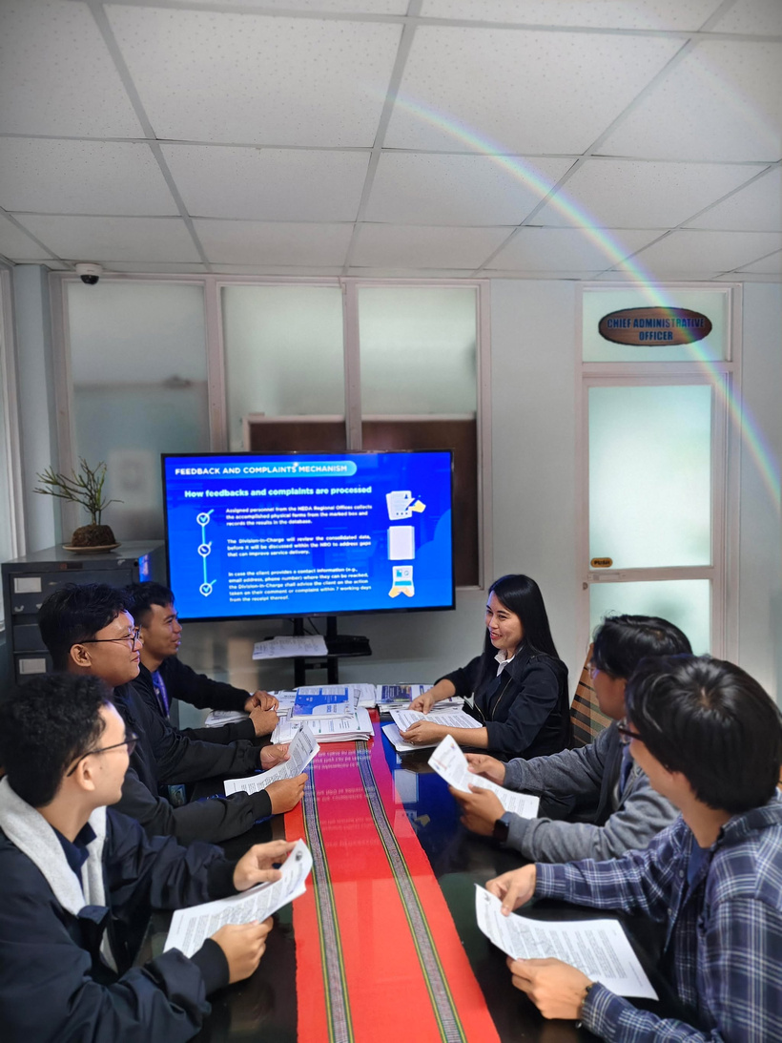


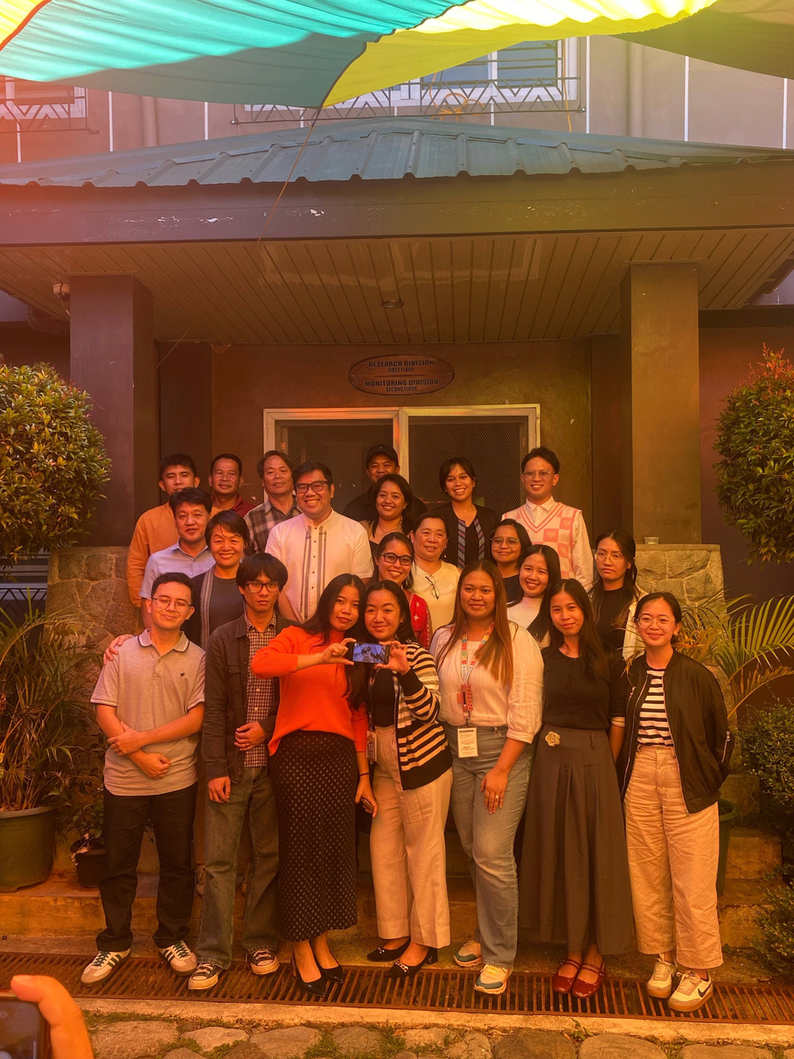
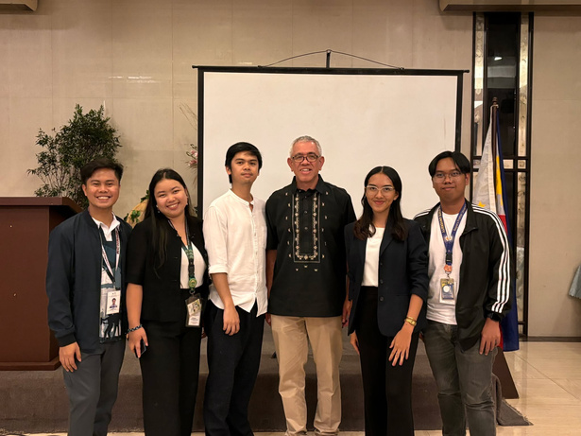
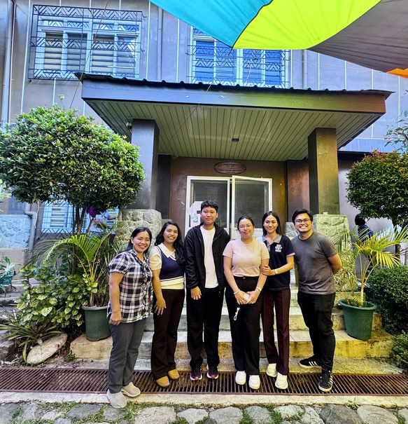
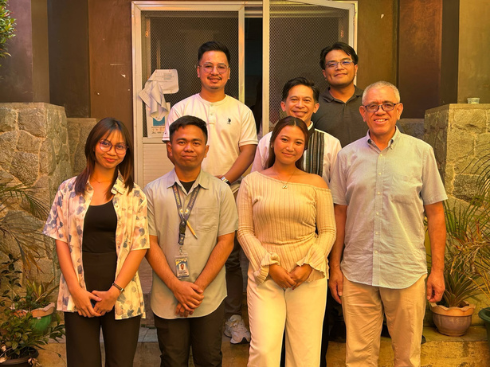
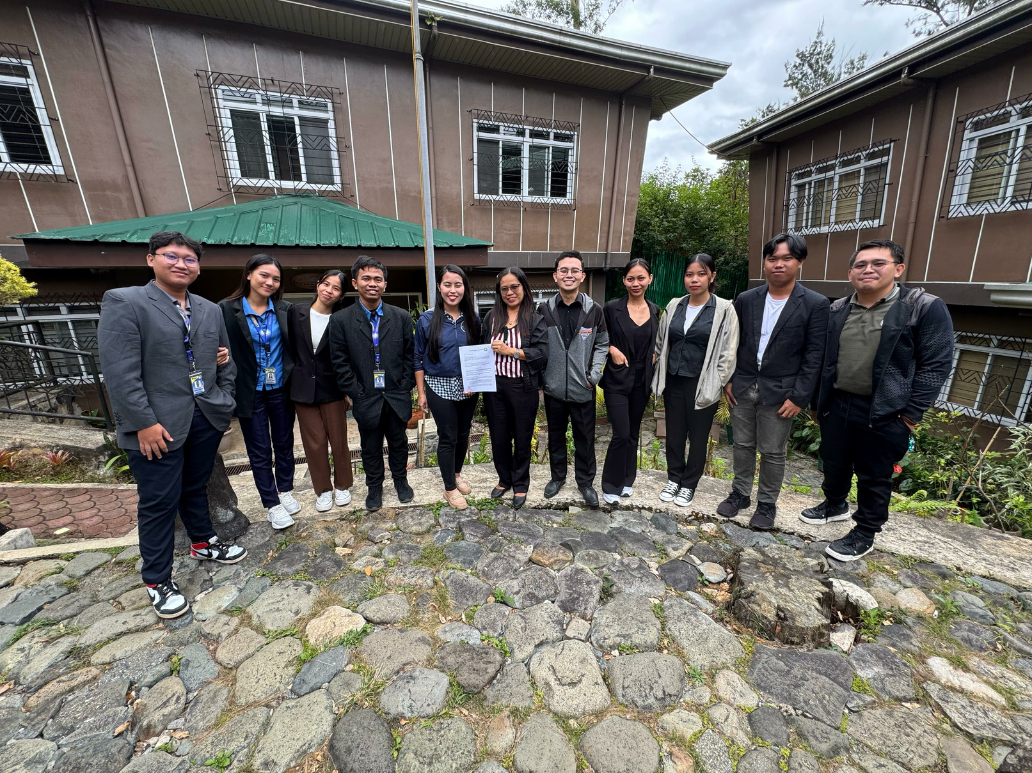
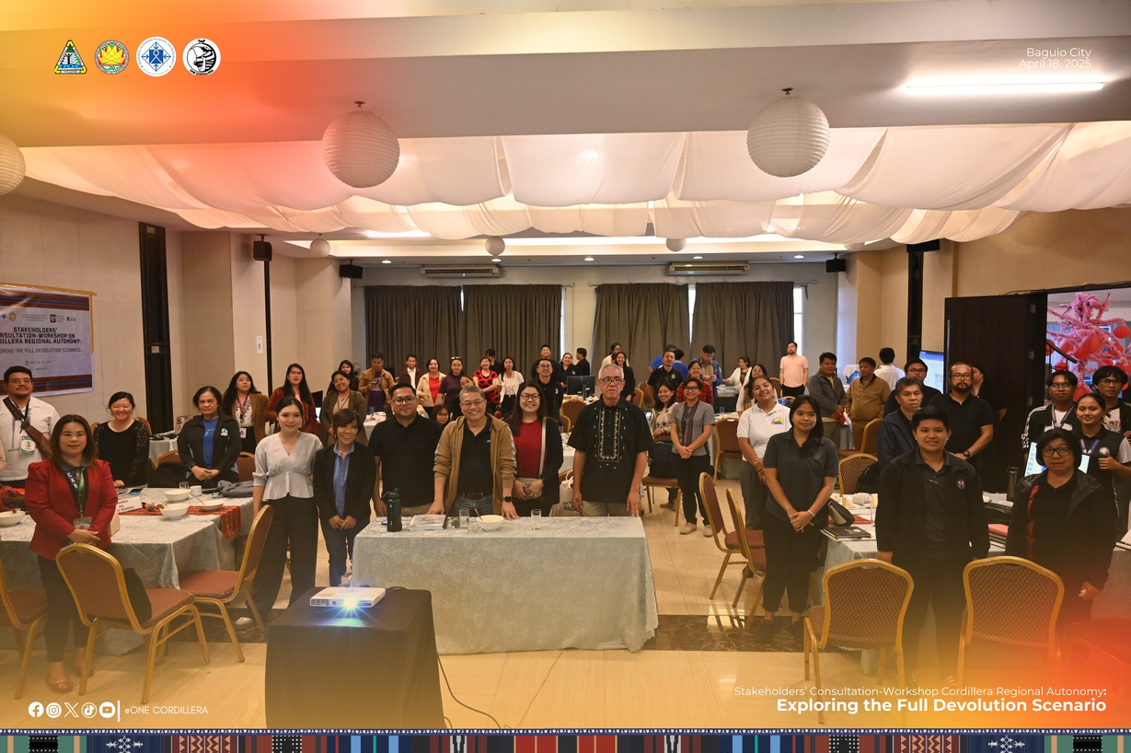
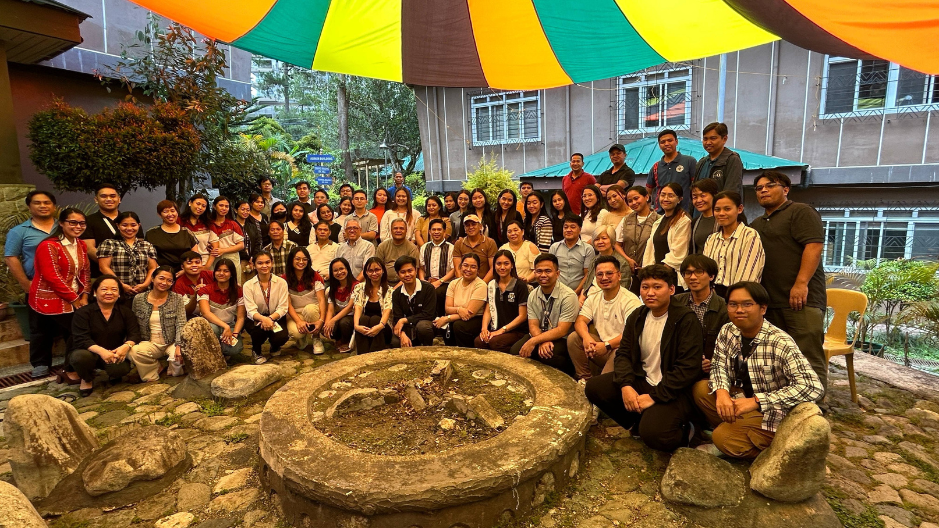
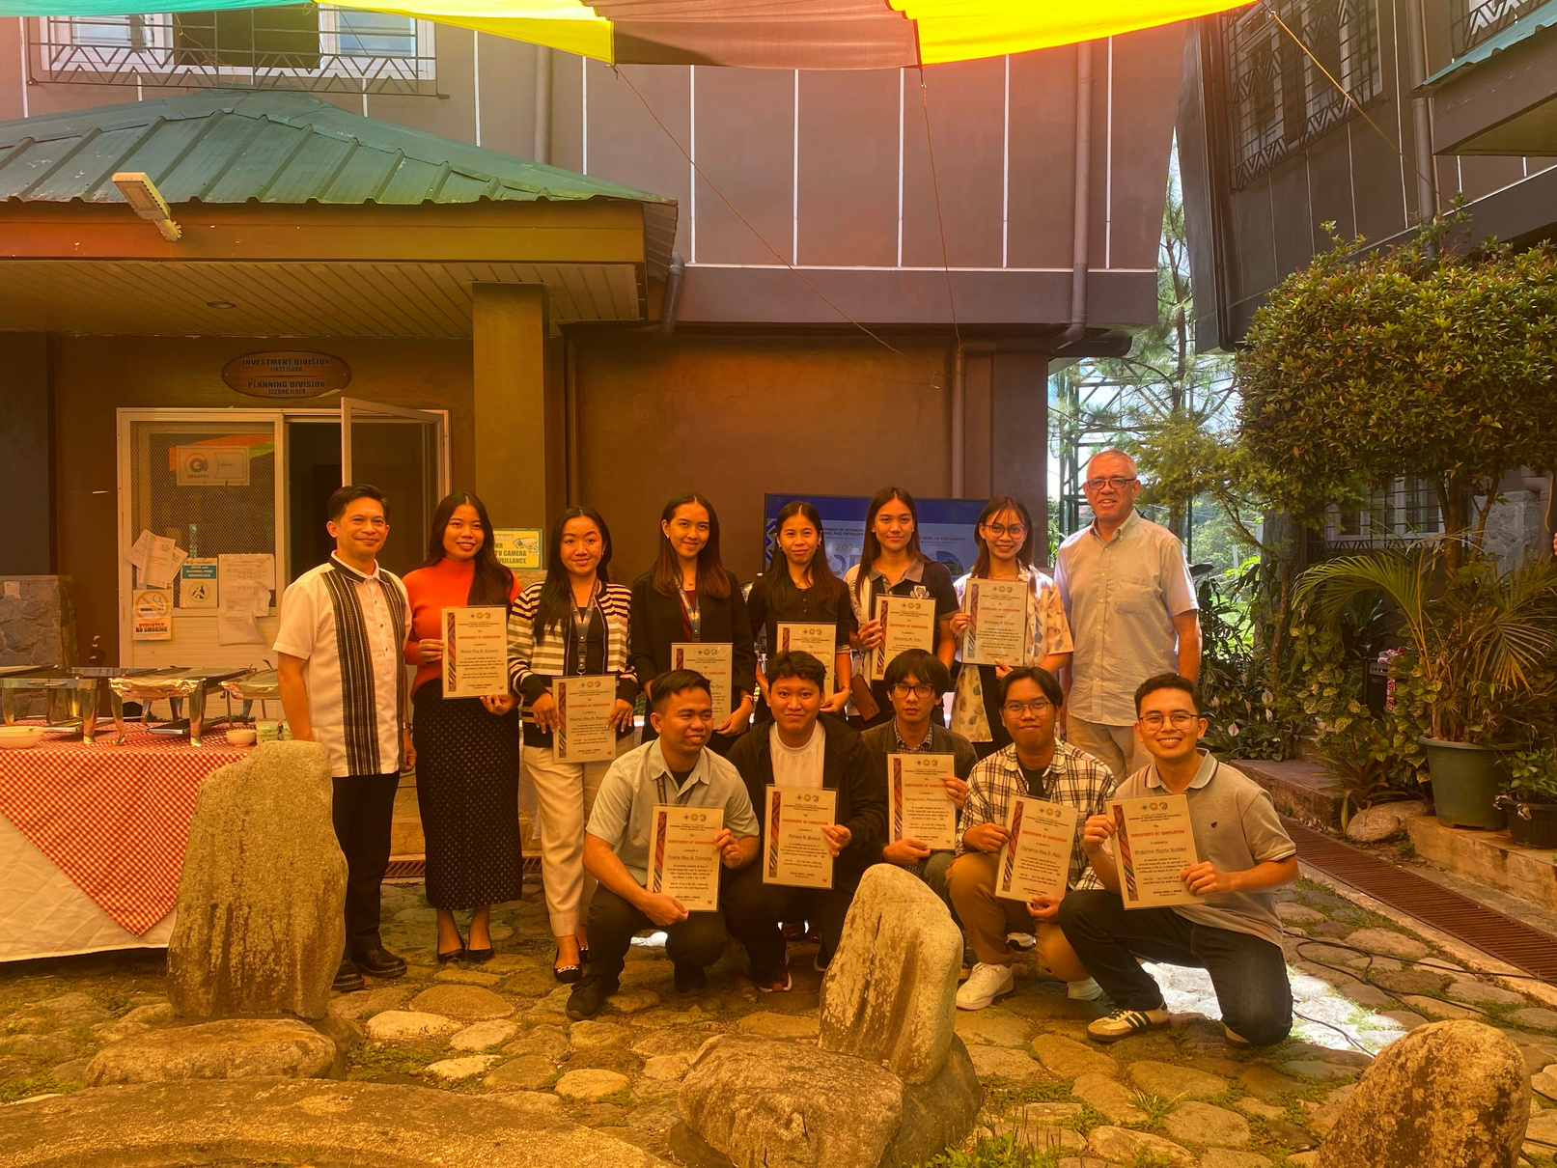
DEPARTMENT OF ECONOMY,
PLANNING, AND DEVELOPMENT
CORDILLERA ADMINISTRATIVE REGION
(DEPDev - CAR Formerly NEDA - CAR)

Slide 2
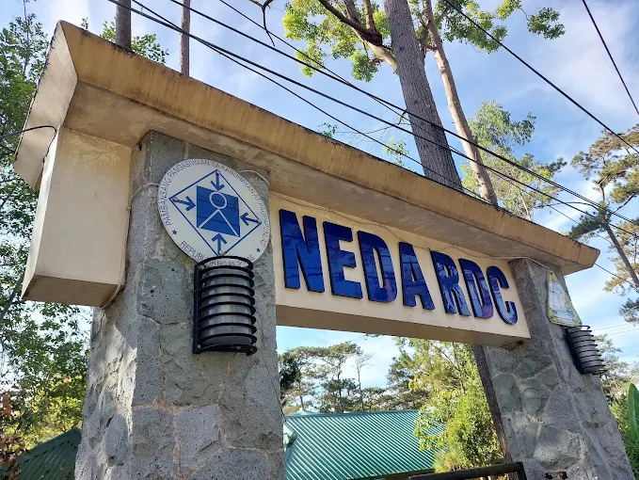
DEPDev - CAR (NEDA - CAR)
The Department of Economy, Planning, and Development – Cordillera Administrative Region (DEPDev-CAR), formerly known as the National Economic and Development Authority – CAR (NEDA-CAR), serves as the primary socioeconomic planning body in the region. Its mandate encompasses the coordination and implementation of development initiatives, policy formulation, and strategic planning to promote inclusive and sustainable growth within the Cordillera Administrative Region (CAR).
In April 2025, through Republic Act No. 12145, NEDA was reorganized into DEPDev, granting it full executive department status to enhance its policy-making and coordination functions across the country.

Slide 3
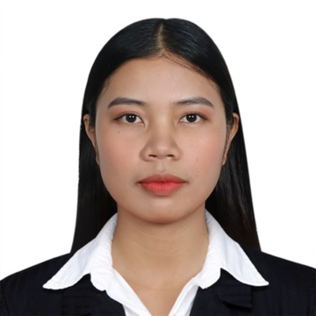
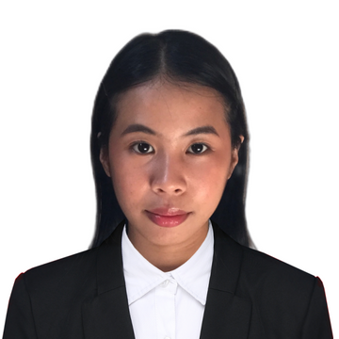

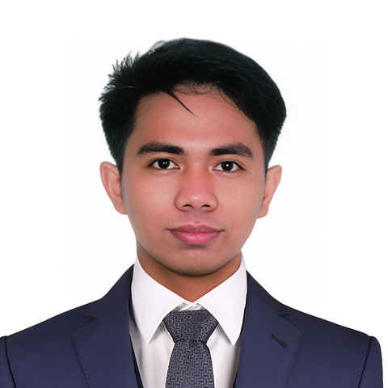
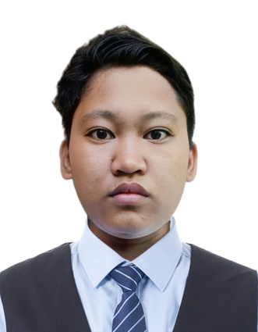
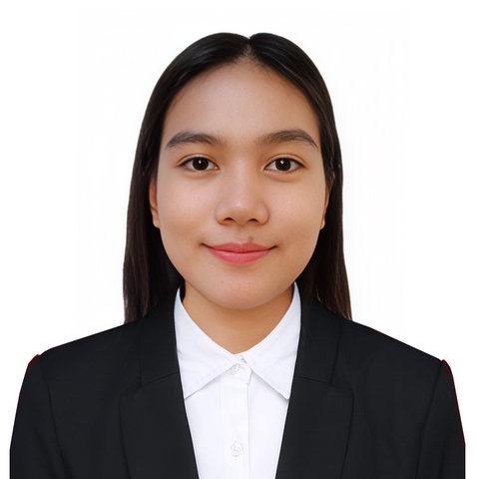
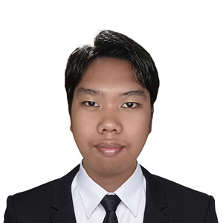
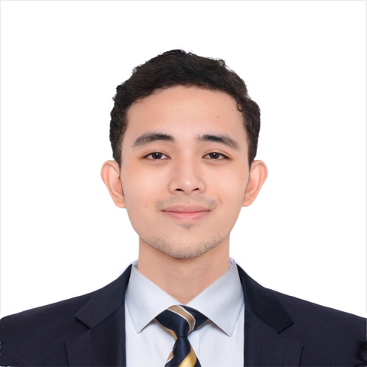
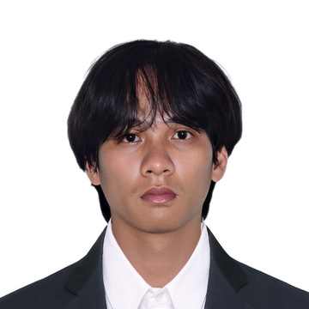
DEPDev - CAR (NEDA - CAR) DIVISIONS
ERICA & MACY
TRISHA & REYMAR
JOSHUA & MARIA FHE
SUPPLY UNIT
ORD
PLANNING
IAN
DANZEL
AARON
SPCAR
HR
PHYSICAL UNIT

Slide 4
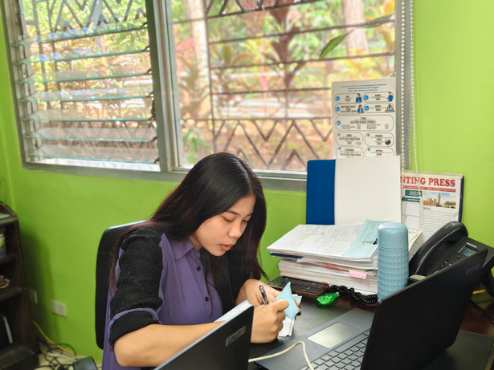
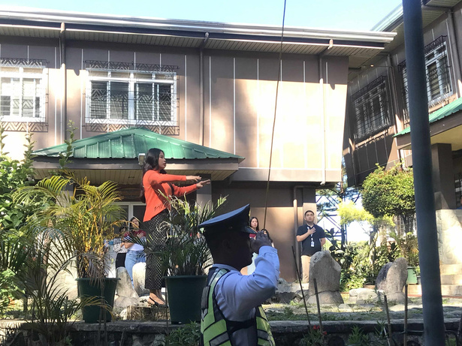
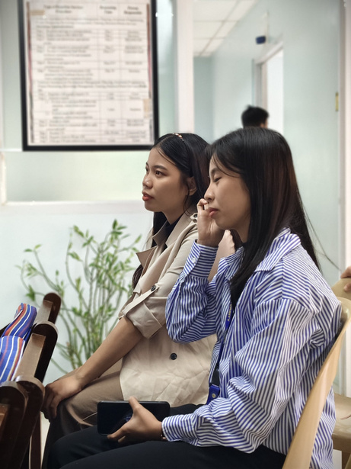
LEARNING EXPERIENCES - SUPPLY UNIT DIVISION
  Handled procurement documents and monitored Purchase Orders (POs)
  Conducted inventory of supplies
  Coordinated with suppliers
  Leading the Flag Raising Ceremony

Slide 5
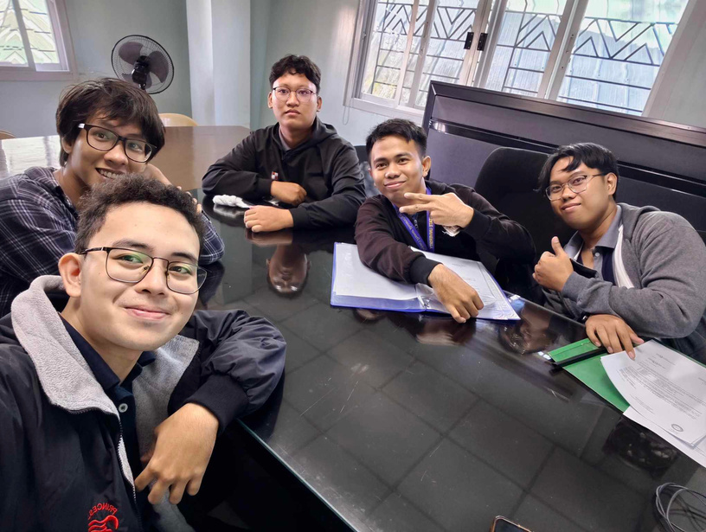
LEARNING EXPERIENCES - HR DIVISION
Technical & Logistical Support
  Designed and printed intern IDs for PSU BYB, PSU SC, CLSU, and SLU OJTs
  Proctored essay exams (SPCAR, EDS II, SAO applicants)
  Created Customer Satisfaction Form (CSF)
  Supported events (e.g., Valentine's, Women's Month, A Cup of Reflection, ‘Salamat! Mabuhay!’)
Media & Documentation
  Provided photo coverage for key DEPDev events and meetings
  Produced AVPs (e.g., NEDA RAISE Awards, tributes, 2nd Quarter meeting)
  Designed social media cards/posters for events and commemorations

Slide 6
LEARNING EXPERIENCES - HR DIVISION
Digital Innovations
  Built HR Digital Repository (Figma + Google Sites)
  Created filter-enabled staff/telephone directories (Google Sheets + Awesome Table)

Slide 7
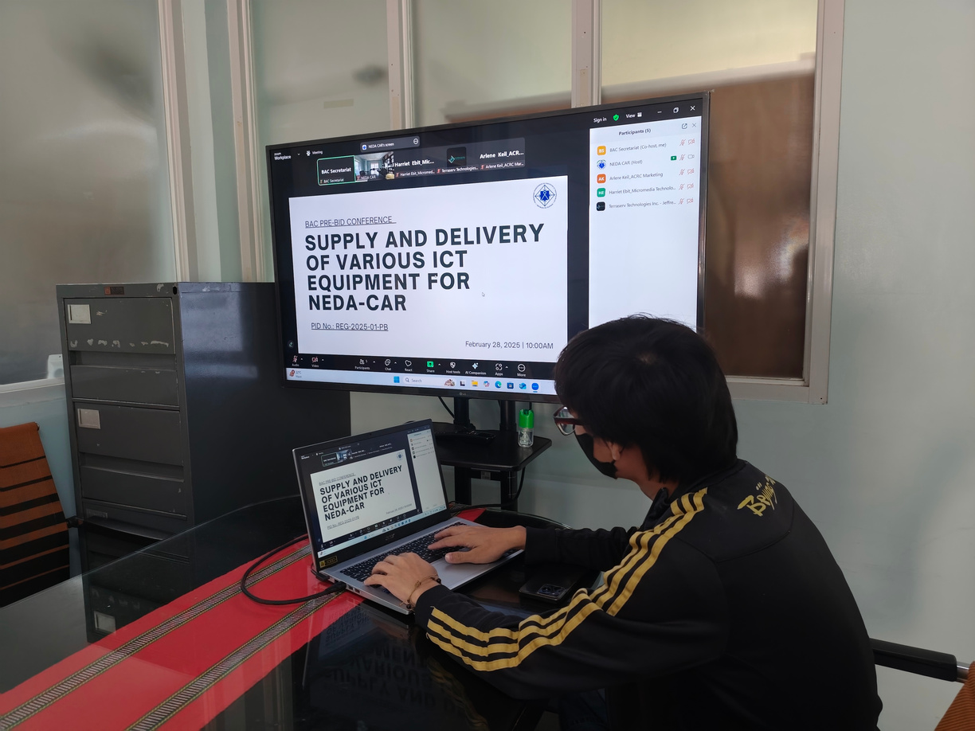
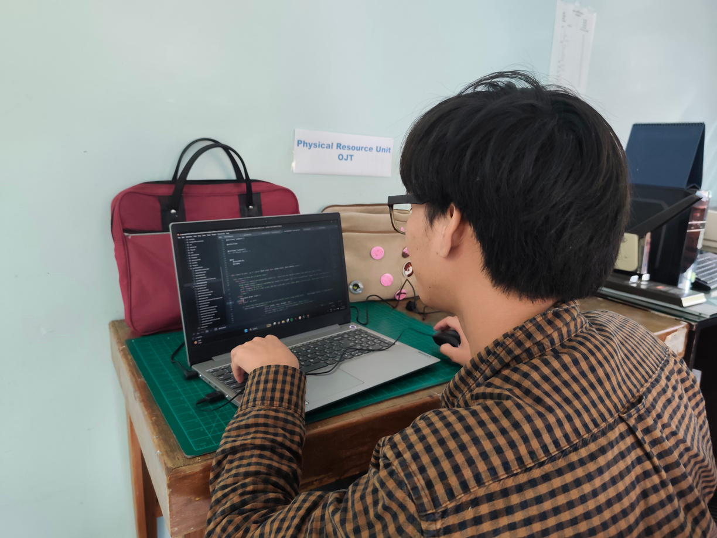
LEARNING EXPERIENCES - PHYSICAL UNIT DIVISION
  Assisted in technical setup and support
  Helped improve the procurement system design

Slide 8
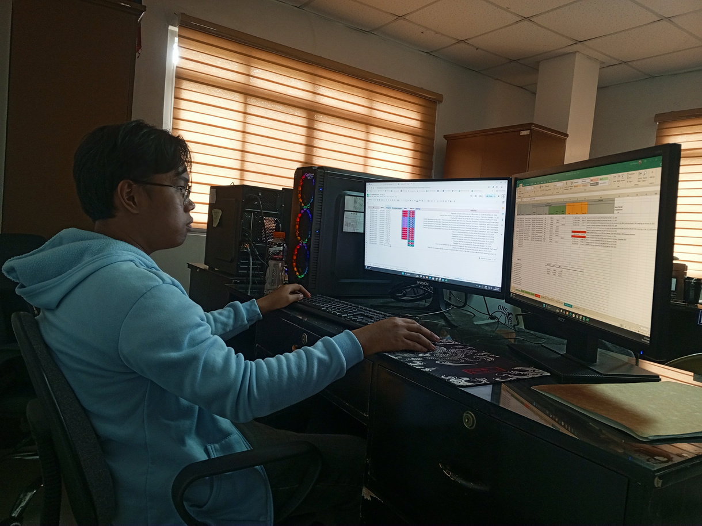
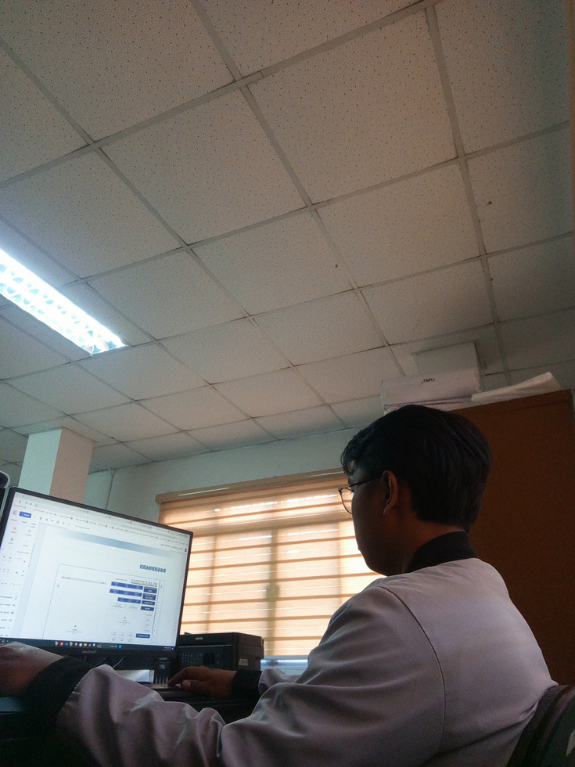
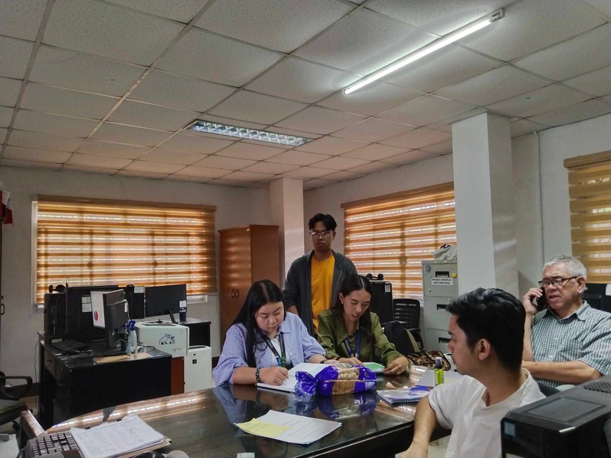
LEARNING EXPERIENCES - SPCAR DIVISION
Website & Analytics
  Re-designed SPCAR’s internal website
  Embedded budget analytics using Looker Studio
  Added interactive and database functionalities
Data & Events Management
  Monitored supplies and consolidated budget/data from agencies
  Created templates for tarpaulins and certificates
  Animated a 2D mascot for autonomy campaign

Slide 9
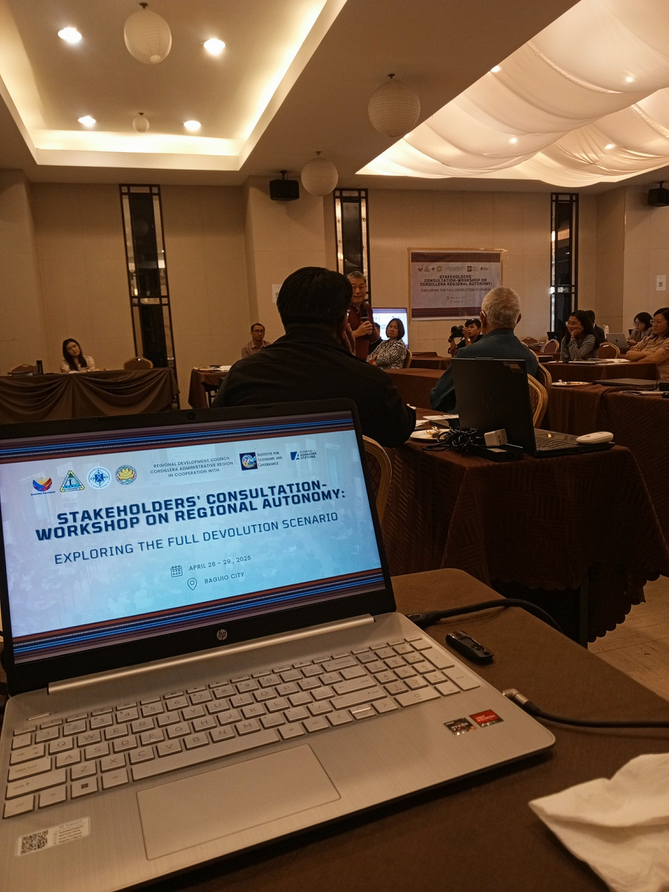
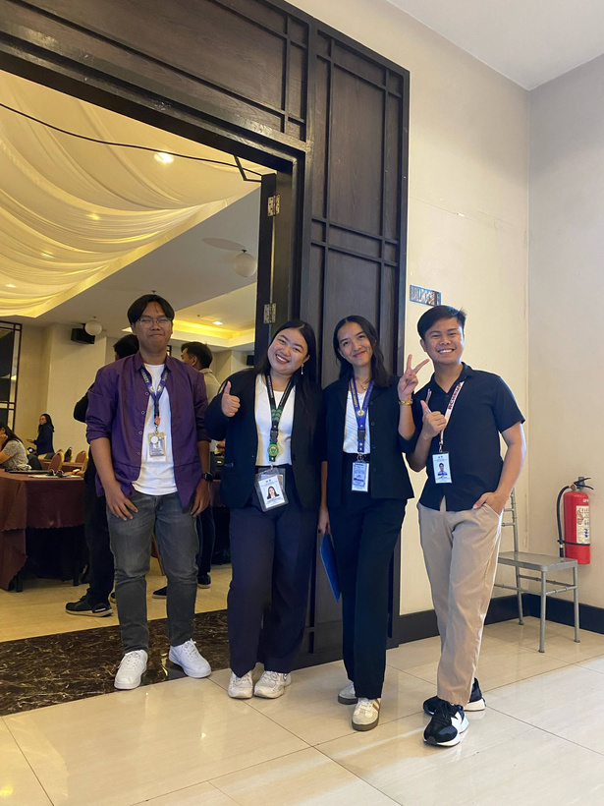
LEARNING EXPERIENCES - SPCAR DIVISION
Workshops & Coordination
  Hosted and managed Zoom coordination meeting
  Mail merged and distributed agency invitations
  Prepared, checked, and transported event utilities
  Operated audio-visuals during 2-day Stakeholders’ Workshop
  Assisted in agency presentations and discussions

Slide 10
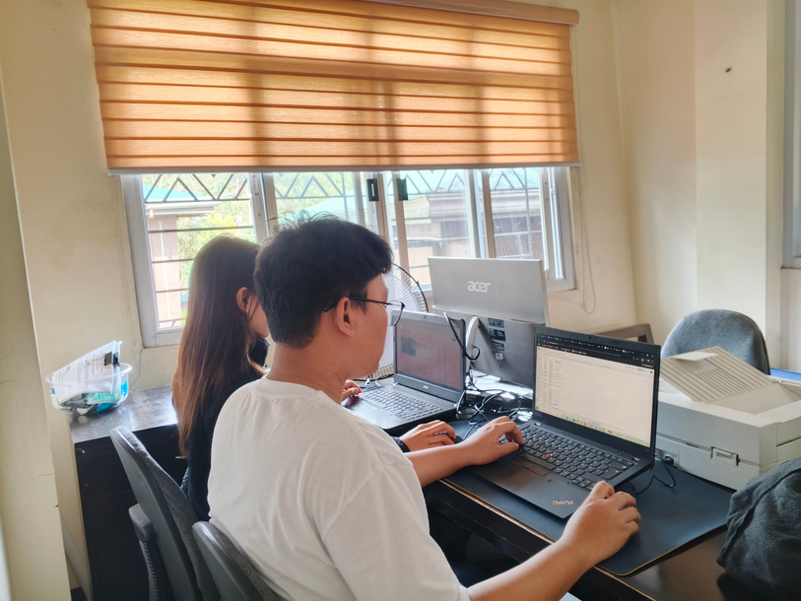
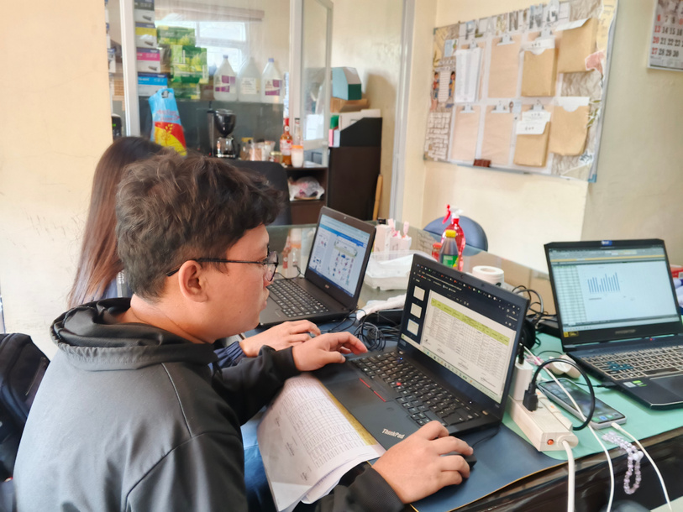
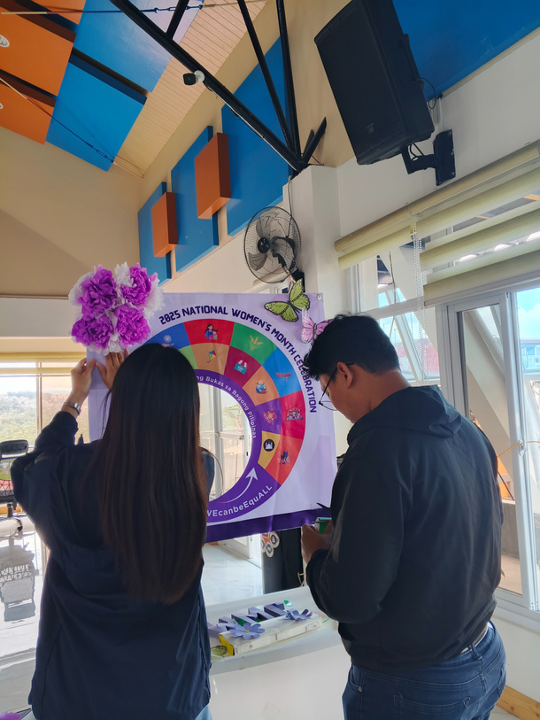
LEARNING EXPERIENCES - PLANNING DIVISION
  Updated policy and planning portal sites
  Created and geo-mapped databases (DOH, DepEd)
  Maintained Network-Attached Storage (NAS)
  Supported 1st Quarter RDC Meeting and RRP Writeshop
  Designed booth for Women’s Month Closing
  Assisted in document printing, sorting, and binding for DevAd Meeting

Slide 11
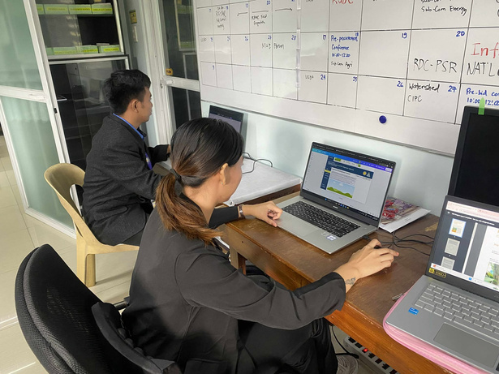
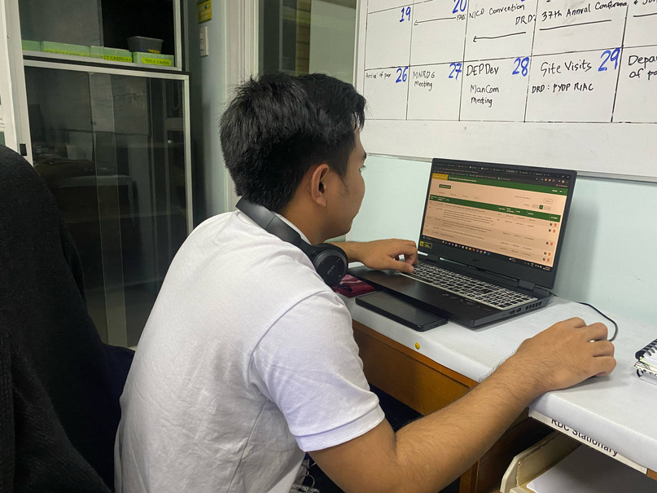
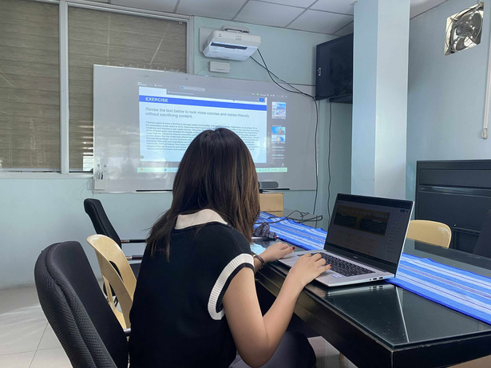
LEARNING EXPERIENCES - ORD DIVISION
  Developed dynamic resolution tracking system
  Edited RDC resolutions and managed transmittals
  Built 2027 National Conference & RDC portal sites
  Designed AVPs, tarpaulins, and meeting labels
  Conducted inventory and created tracking matrix
  Participated in autonomy and inter-agency workshops
  Researched BARMM, NCMF, IAG, and DEPDev-CAR
  Attended planning and agency transition meetings
  Led graphics and design improvements for sites and internal assets

Slide 12
general impression
Our internship at DEPDev-CAR was a truly enriching experience that gave us a deeper understanding of how a government planning agency operates in real-world settings. Each division—from HR, SPCAR, ORD, Planning, to Physical Resources and Supply—offered distinct roles that allowed us to apply our academic knowledge while learning new technical and interpersonal skills. Whether we were building websites, designing communication materials, managing databases, or supporting major regional events, we saw how every task—big or small—contributes to the broader goals of inclusive and sustainable development.
We are genuinely grateful to the entire DEPDev team for their guidance, patience, and trust throughout our internship journey. The welcoming environment, collaborative spirit, and supportive mentorship helped us grow not just as trainees, but as individuals preparing for the professional world. Being part of DEPDev’s mission, even in a small way, has left a lasting impact on us. Thank you for allowing us to learn, contribute, and be inspired by the work that truly makes a difference in the region.

Slide 13
DEPDev - CAR (NEDA - CAR) DIVISIONS
ERICA C. FRIAS
MACY GRAY AGBUYA
SUPPLY UNIT DIVISION

Slide 14
DEPDev - CAR (NEDA - CAR) DIVISIONS
TRISHA MAE TORRALBA
REYMAR GALSIM
ORD DIVISION

Slide 15
DEPDev - CAR (NEDA - CAR) DIVISIONS
MARIA FHE ROSARIO
JOSHUA E. TAMONDONG
PLANNING DIVISION

Slide 16
DEPDev - CAR (NEDA - CAR) DIVISIONS
DANZEL REIGE B. PEREZ
HR DIVISION

Slide 17
DEPDev - CAR (NEDA - CAR) DIVISIONS
AARON KING C. ABALOS
PHYSICAL UNIT DIVISION

Slide 18

DEPDev - CAR (NEDA - CAR) DIVISIONS
IAN JAY P. MACARAEG
SPCAR DIVISION

Slide 19


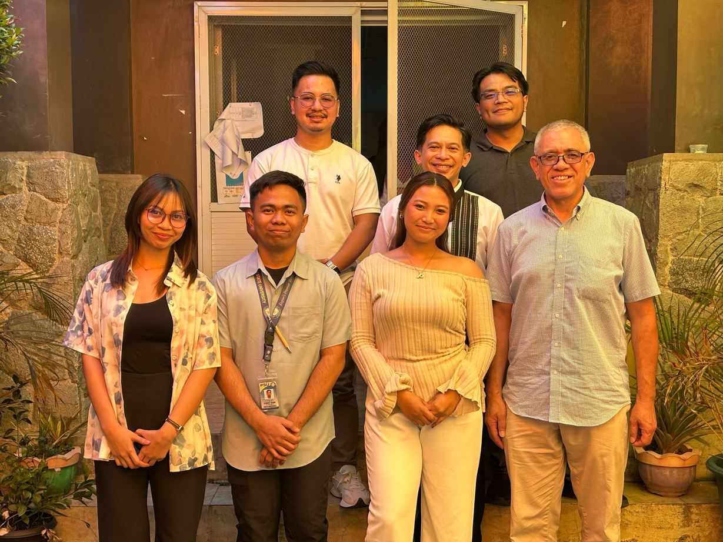
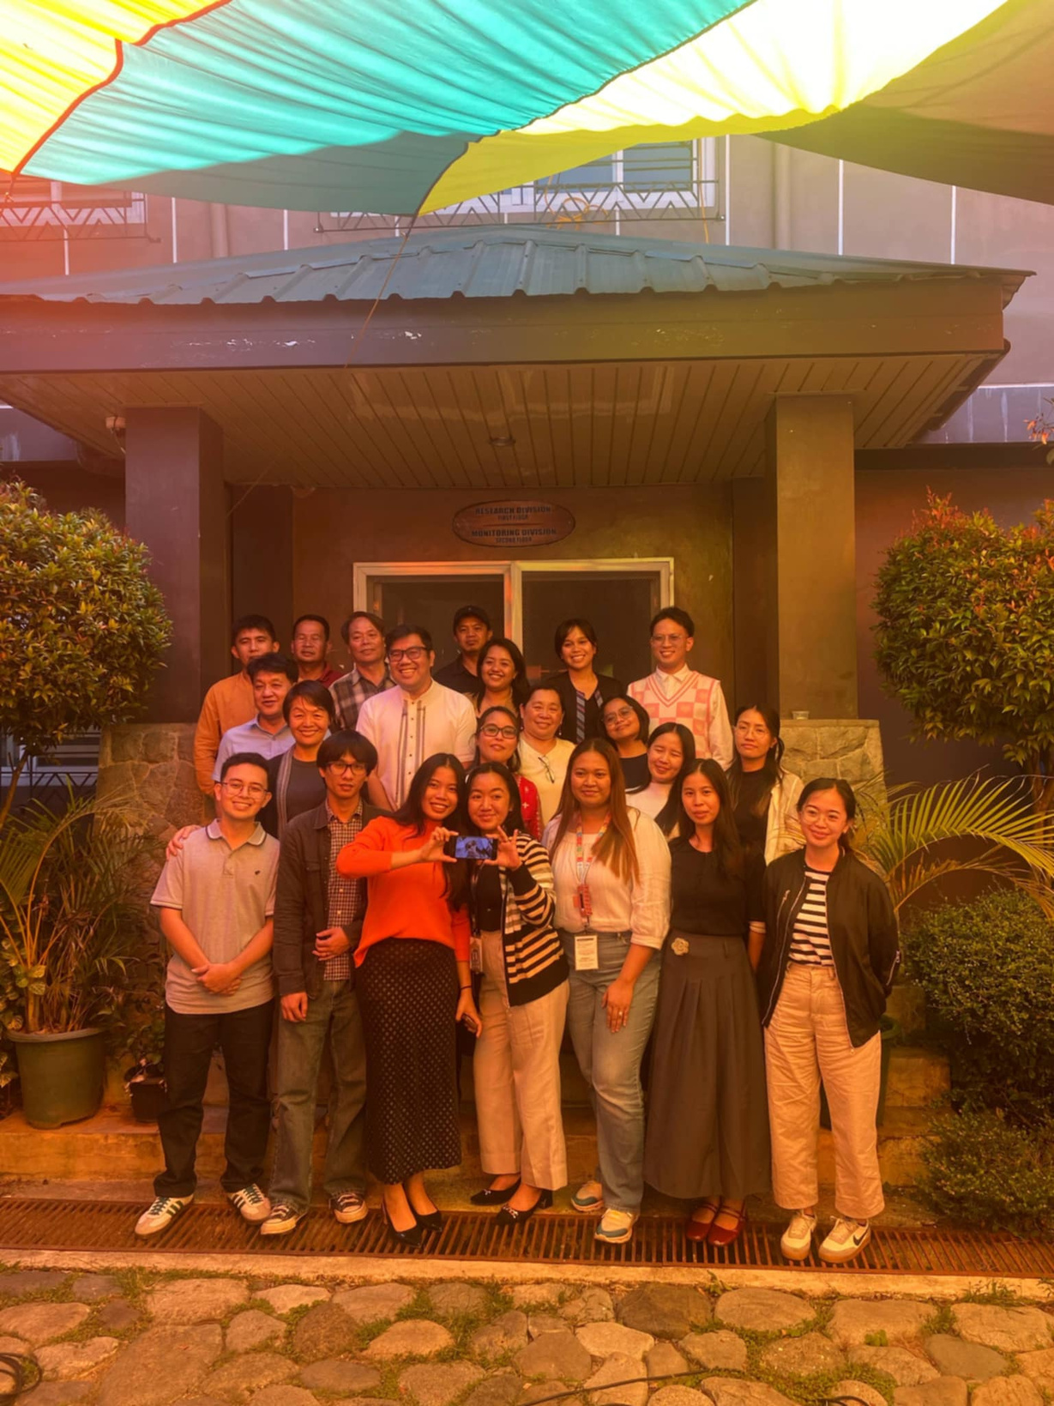
THANK YOU DEPDev - CAR!

